Slide 1
Book Recommendation System
Collaborative Filtering Based Recommendation Engine

Slide 2
Project Team
Mentor Name: Saigeetha k
Team Members:
MARPU ANIL KUMAR
Mandam DeviPrasad
Asha Sidgiddi
Rupavath Sridevi
Revathilatha S
Rani Bhanudas Mali

Slide 3
Project Objective
Recommend books based on user similarity
Improve user experience using personalized suggestions
Build an interactive Streamlit application

Slide 4
Dataset Details
• Books Dataset
• Ratings Dataset
• Users Dataset
• Features Used: User-ID, ISBN, Ratings, Author, Country

Slide 5
Problem Statement
Users face difficulty finding relevant books from a large collection. The system solves this by recommending books based on similar users and ratings.

Slide 6
Data Cleaning
• Removed missing values
• Replaced invalid ages using median
• Removed duplicate records
• Filtered implicit ratings

Slide 7
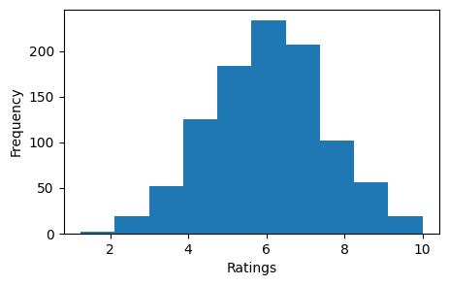
Exploratory Data Analysis
Most books received low ratings
Few books were highly popular
Ratings distribution was highly skewed

Slide 8
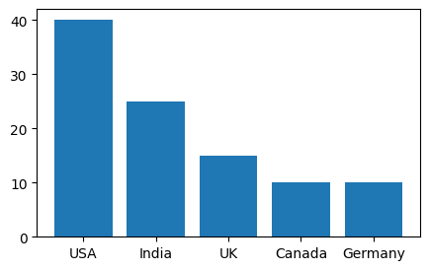
User Analysis
Majority of users belonged to adult age group
Users came from multiple countries
Country-based filtering improved personalization

Slide 9
Book Analysis
Some authors dominated the dataset
Popular books received more interactions
Image URLs used only for UI display

Slide 10
Feature Engineering
Created User-Book Matrix
Built Similarity Matrix using Cosine Similarity
Generated Country-based filtering

Slide 11
Recommendation Approach
Collaborative Filtering
User-User Similarity
Recommended unread books from similar users

Slide 12
Model Building
Created sparse matrix
Applied cosine similarity
Selected top similar users

Slide 13
Cold Start Problem
New users handled using Popular Books recommendation
Improved system robustness

Slide 14
Final Recommendation Logic
Identify similar users
Find highly rated books
Remove already-read books
Recommend top books

Slide 15
Model Evaluation
Recommendations were relevant for active users
Similar users produced better personalized suggestions

Slide 16
Application Overview
Developed using Streamlit
User enters User-ID
Displays recommended books with images

Slide 17
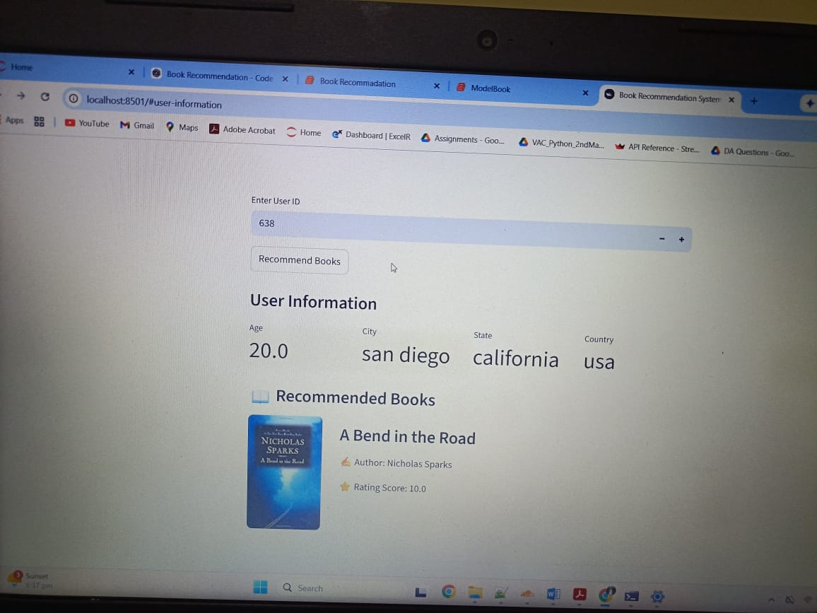

App Screenshot Placeholder
Add Streamlit App Screenshot Here

Slide 18
Challenges Faced
Large dataset processing
Handling missing values
Cold-start problem
Sparse matrix issues

Slide 19
Project Improvements
Add content-based filtering
Add hybrid recommendation system

Slide 20
Business Impact
Improves user engagement
Personalized recommendations increase retention
Better book discovery experience

Slide 21
Conclusion
The recommendation system successfully provides personalized book suggestions using collaborative filtering techniques.

Slide 22
Thank You
Questions & Answers

